Slide 1


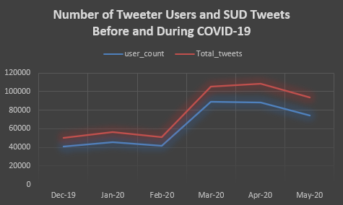
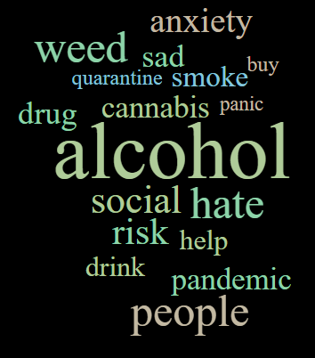
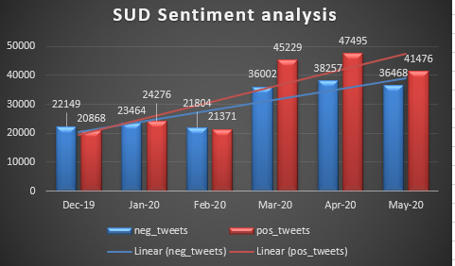
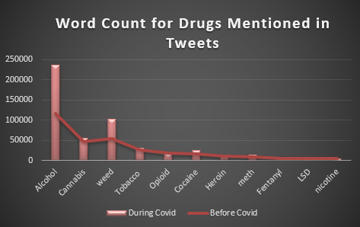
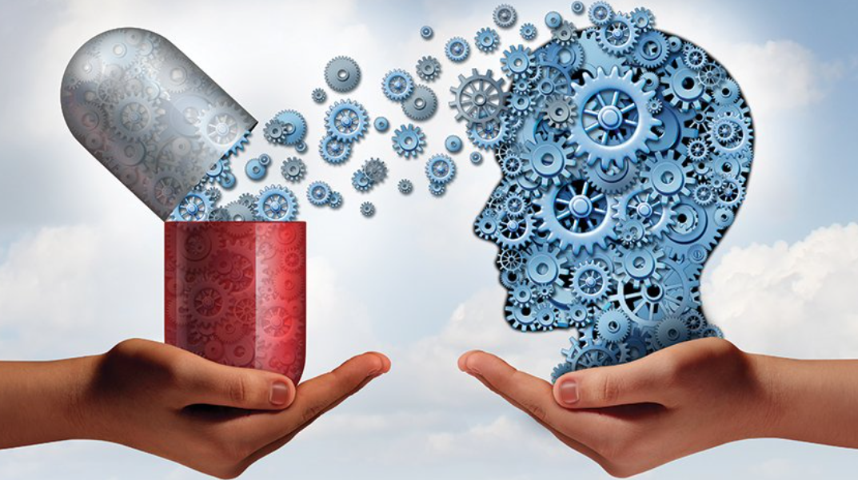
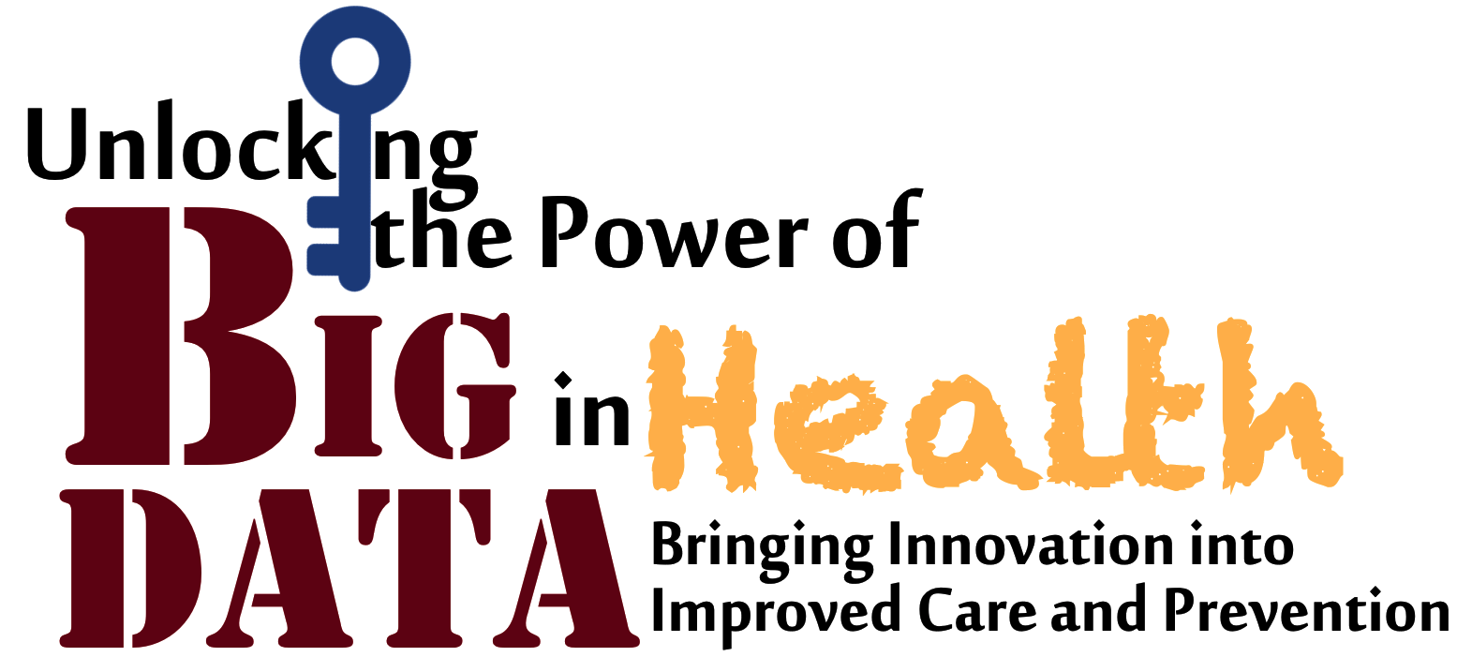
Exploring Substance Use Disorder (SUD) Patterns on Twitter
Before and During COVID-19 Pandemic
Avineet Kumar Sigh and Dezhi Wu*, PhD
College of Engineering and Computing
University of South Carolina
Columbia, SC 29309
*Corresponding Author: dezhiwu@cec.sc.edu
Abstract
Previous Work
Results
The ongoing COVID-19 pandemic has significantly changed healthcare systems globally with currently over 104 million of cases and 2.26 million death as of Jan. 2021. Substance use disorder (SUD) users are regarded as vulnerable population for contamination due to their clinical, psychological, and psychosocial conditions. During the pandemic, social, financial, and psychological risks can favor and intensify SUD in a drastic way, worse, the SUD users’ risks associated with COVID-19 infection are also high. It is likely that the pandemic can trigger more substance consumption and negative mental health outcomes. Social media platforms such as Twitter are where many users post and share their opinions, and they become increasingly important to serve as public health surveillance tools due to their real-time ways of disseminating information in the public. In this study, we intended to explore the SUD posting patterns on Twitter before and during the COVID-19 pandemic. Our preliminary results show that there was a striking increase on the number of SUD-related tweets and unique Twitter users expressing both positive and negative emotions during the pandemic compared to pre-COVID-19 period. Future research is needed to uncover the underlying mechanisms for such trends.
Studies have shown that consumption of tobacco, alcohol, sedatives, and illicit drugs is highly prevalent among homeless women in comparison to general population [1]. These studies were usually done using surveys on certain group of population which is time consuming and expensive. Monitoring social media not only helps to understand the trend but also respond to the rapidly evolving effects of health policies. Previously social media study [2] discovered shifts to suicidal ideation from mental health content on twitter. Twitter has also been used to draw insights into US Mental Health during the COVID-19 pandemic [3]. In this study, we aim to understand the trend of SUD-related tweets and their sentiment before and during COVID-19 pandemic.
Fig. 4: Word Clouds in SUD Tweets
Methods
Fig. 1: Number of Unique Twitter Users and SUD Tweets
Preliminary Findings
Data Collection Phase
Social Media Platform: Twitter
Time Period: Before COVID: Dec. 2019 to February 2020
During COVID: March 2020 to May 2020
Keywords Used: 1,860
Python library: Twint
Tweets extracted: 466,188
Advantages: 1) Using keywords helps to identify specific tweets from a large set of tweets making the analysis part easier and more accurate.
2) ‘Twint’ library gives the option to access the tweets of any date and any topic. There were no restrictions for scraping a large number of tweets or accessing older tweets.
Data Analysis Phase
Word Analysis:
1) irrelevant words and special characters were removed.
2) tokenized each tweet into words and calculated the frequency of each word and its monthly trend.
Sentiment Analysis:
We have used TextBlob Python library for processing textual data. It provides access to common text-processing operations through an API.
Based on our analyses on the extracted SUD related tweets, we found the following preliminary patterns:
SUD tweets increased by 68% during COVID.
Number of users tweeting increased by 110% in March 2020.
Use of drug words like alcohol and weed doubled whereas cocaine, meth and LSD increased by 50%.
Negative sentiment of SUD related tweets increased compared to positive sentiment tweets during the pandemic, signifying the adverse effects caused when the lockdown period
People strongly opposed ban of Alcohol during month of April 2020, as they considered consuming alcohol to reduce depression.
Fig. 2: SUD Sentiment Analysis
Introduction
References
[1] Guillen, A. I., Marin, C., Panadero, S., and Vazquez, J. J. (2020), “Substance use, stressful life events and mental health: A longitudinal study among homeless women in Madriod (Spain),” Addicitive Behaviors, 103, 103246, 7 pages.
[2] Choudhury, M. D., Kiciman, E., Dredze, M., Coppersmith, G., and Kuman, M. (2016) “Discovering shifts to suicidal ideation from mental health content in social media,” Proceedings of ACM CHI 2016 Conference, San Jose, CA.
[3] Valdez, D., Thij, M. T., Bathina, K., Rutter, L. A., and Bollen, J. (2020). “Social media insights into US mental health during the COVID-19 pandemic: Longitudinal analysis of Twitter data,” Journal of Medical Internet Research, 22(12), pp. 1-11.
The study conducted by NIH indicated that the strongest adverse COVID-19 effects were seen in those with opioid or tobacco use disorders. It was found that while patients with a SUD make up 10.3% of the U.S. population, SUD patients represented 15.6% of the nation’s COVID-19 cases. Population with SUDs are at a higher risk of getting affected by the virus not only because of their health issues but also because they are mostly homeless as compared to the general population and are exposed to the environment even during the lockdown. They have limited access to the healthcare systems and during this time the hospitals and clinics are also pushed to their capacity, which worsens their chance of getting treated. States in US were also urged to ban alcohol sales during the COVID-19 crisis to reduce the damage to public health.
Acknowledgements
Fig. 3: Mentioned Drugs in SUD Tweets
The authors would like to acknowledge the funding support provided by the University of South Carolina [Grant No: 80002838 (Wu)], and to thank Dr. Phyllis Raynor for her clinical advice on keyword selections. Any opinions, recommendations, and conclusions expressed in this project do not necessarily reflect the view of the funding agent.
Sample Tweets:
(Feb 2020) Beware of posting opinionated, self-absorbed, or drug- or alcohol-based content on social media--it could cost you your next job. https://t.co/ylOwjXw5sg
(Mar 2020) I heard cocaine, weed, alcohol beverages etc., may help reduce the risk of corona virus infection. All I understand from this is just We all should GET HIGH always #CoronaOutbreak #coronavirusnigeria #CoronavirusPandemic #CoronavirusOutbreak #coronavirus https://t.co/vXVxqzDg6Y
(Apr 2020) @VijayShadean @MYANC The dangers of banning 1. Affect the Psychological &amp; physical well being , 2. Riots 3. Revenue lost 4. Illegal trade 5. Job losses. Can follow. What is really going in here SA is a developing country , they know nothing , its not their field of expertise, alcohol PPL Suffer DT
National Big Data Health Science Conference

